Slide 1
Mental Disorders and their treatment Module 5

Slide 2
Well being and happiness
Positive Psychology’s (PP) primary focus is on what people do right to obtain and maintain optimum happiness (Compton, 2005), by striving to understand and help people develop qualities that lead to greater personal fulfilment.
The premise of PP is to promote factors that allow individuals to thrive and flourish by encouraging a change of focus in psychology from a preoccupation with repairing the worst things to a greater emphasis on discovering and building upon positive qualities.

Slide 3
Positive psychology is firmly based on humanistic theory
It takes interest in subjective experiences such as subjective wellbeing/happiness, flow, joy, optimism and hope.
It has an interest in the thriving individual, paying particular attention to character strengths and virtues such as courage, perseverance, open-mindedness and wisdom.
It aims to identify, study and enhance those qualities that improve on the positive subjective experiences and adaptive personality traits of individuals (Robbins, 2008).

Slide 4
The concept of happiness is the corner stone of the assumptions of positive psychology.
Happiness is characterized by the experience of more frequent positive affective states than negative ones as well as a perception that one is progressing toward important life goals (Tkach & Lyubomirsky, 2006).
Certain kinds of environmental factors or conditions have been found to be associated with happiness and include such things as; individual income, labour market status, health, family, social relationships, moral values and many others (Carr, 2004; Selim, 2008; Diener, Oishi & Lucas, 2003)
There are two main theoretical perspectives which focus on addressing the question of what makes people feel good and happy.
These are the hedonic and eudaimonic approaches to happiness (Keyes, Shmotkin, & Ryff, 2002

Slide 5
Hedonic well-being is based on the notion that increased pleasure and decreased pain leads to happiness.
Hedonic concepts are based on the notion of subjective well-being.
Subjective well-being is a scientific term that is commonly used to denote the ‘happy or good life’.
It comprises of an affective component (high positive affect and low negative affect) and a cognitive component (satisfaction with life).
It is proposed that an individual experiences happiness when positive affect and satisfaction with life are both high (Carruthers & Hood, 2004)

Slide 6
Eudaimonic well-being, on the other hand, is strongly reliant on Maslow’s ideas of self-actualisation and Roger’s concept of the fully functioning person and their subjective wellbeing.
Eudaimonic happiness is therefore based on the premise that people feel happy if they experience life purpose, challenges and growth.
This approach adopts Self-Determination Theory to conceptualise happiness (Keyes et al., 2002; Deci & Ryan, 2000).
Self-determination theory suggests that happiness is related to fulfilment in the areas of autonomy and competence.
From this perspective, by engaging in eudaimonic pursuits, subjective wellbeing (happiness) will occur as a by-product.

Slide 7
Hedonic (Subjective Wellbeing): Presence of positive mood, absence of negative mood; satisfaction with various domains of life (e.g. work, leisure); global life satisfaction
Eudaimonic (Psychological Wellbeing): Sense of control or autonomy; feeling of meaning and purpose; personal expressiveness; feelings of belongingness; social contribution; competence; personal growth; self-acceptance.

Slide 8
Factors contributing to happiness and well being:
Personality Traits and Happiness
Biology of happiness: Dopamine
Family environment, education level, and cultural factors all have an impact on an individual’s sense of happiness and wellbeing (Compton, 2005)
Culture
Authentic happiness: the combination of behaviours that constitutes happiness and a good life; in this context refers to both the ability to recognise and take responsibility for one’s own psychological experiences and the ability to act in ways that are consistent with those experiences. Authentic happiness is thought to derive from the identification and cultivation of signature strengths and virtues (Robbins, 2009).

Slide 9
Mental health and Hygiene
Mental hygiene: the art of developing, maintaining, and promoting necessary behavioural, emotional, and social skills to sustain good, effective and efficient mental health
Mental ill-health is defined as the absence of the qualities of positive mental health in the individual
Factors associated with MH:
Reality contact
Impulse control
Self esteem
Positive thoughts
Self care

Slide 10
Mental Disorders and their treatment
Many terms may be used, such as “mental illness”, “mental health problems” or “behavioral disorders.”
Each disorder is different in each person.
There is no “have it” or “don’t have it”. Mental health is a continuum or spectrum.
Mental disorders vary from person to person and from time to time.

Slide 11
Most persons with identified mental disorders respond positively to treatment.
A person cannot “catch” a mental disorder from another person, although genetics do influence the development of some disorders.
Parents with mental disorders do not necessarily “cause” disorders in their children.

Slide 12
Judging abnormality and psychological disorder
Social context: Szaz (1960) and Scheff (1966) suggest deviation from accepted social norms
Distress in others: deviation that causes distress to those around, across situations
Subjective distress of the individual : (I) feelings of dissatisfaction, sadness, anxiety or lethargy; (2) physical complaints such as nausea or headaches; (3) unwanted thoughts or impulses
A matter of degree
Impairment in adaptive functioning

Slide 13
Impact of mental disorders
Thought processes, moods and emotions are affected by mental disorders.
Mental disorders are biologically based.
What matters most is the life impact.
Disorders can be more, or less, serious, and may change over time.
Cause is less important than current impact.
Violence is not associated with all disorders.

Slide 14
The Recovery Model
Persons with mental disorders can, on their own or with treatment, learn to function positively and effectively in the community.
Early identification, appropriate assessment, effective care planning and appropriate treatment make a difference.
Persons with mental disorders can successfully and safely raise their children into adulthood.

Slide 15
Classification systems
ICD 11 (WHO)
DSM V

Slide 16
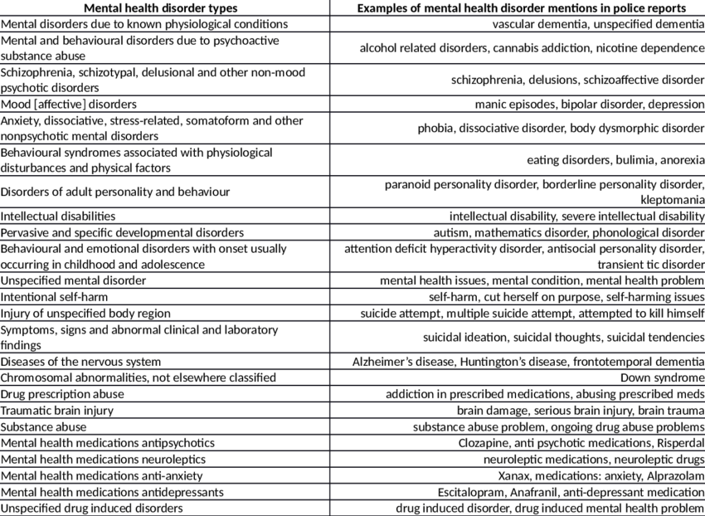
Categories of psychological disorders

Slide 17
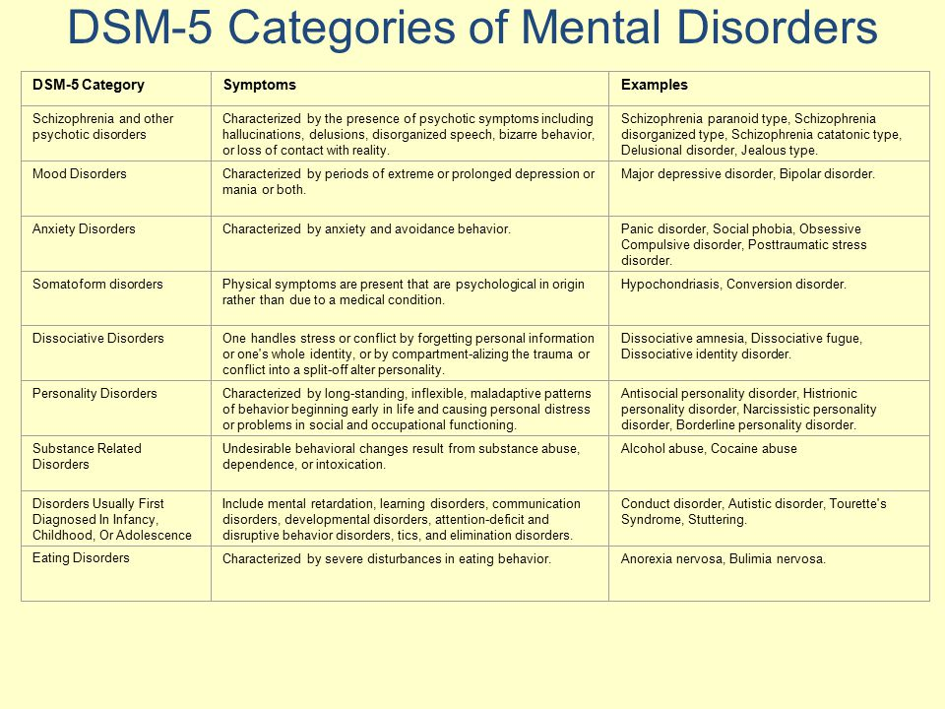

Slide 18
Psychological disorders
In childhood and adolescence: mental retardation, autism spectrum disorders, ADHD, eating disorders, mood disorders, psychosis, anxiety disorders
Substance use disorders
Schizophrenia and delusional disorders
Mood disorders
Anxiety disorders
Personality disorders

Slide 19
Therapy models
Behavioral–cause is secondary; primary goal to understand A-B-C and change behaviors
Biological–treats the physical root cause
Ecological–cause and treatment lie with the interaction between the person and their environment.
Interactive–all other models may be used
Psychoanalytic–internal mental life and past experience drive a person’s reality

Slide 20
Treatment
Evidence-Based Practices (EBPs)
EBP Resource Kits (SAMHSA/CMHS)
Illness management and recovery
Assertive Community Treatment
Family psychoeducation
Supported employment
Co-occurring Disorders: Integrated Dual Diagnosis treatment

Slide 21
MH Interventions
Medication
Education
Counseling or Therapy
Care Management Respite Care
Assertive Community Treatment (ACT) Teams
Self-Help Groups
Residential or Institutional Care

Slide 22
Resistance to treatment
People don’t always follow recommendations: – Treatment is the person’s choice
Reinforcement and support helps Treatments effect different people differently
Finding alternatives

Slide 23
Impact of trauma on parents in child welfare
Trauma increases risk for mental disorders.
Parents learn to parent from their parents.
Childhood trauma affects parenting.
Child abuse sometimes crosses generations.

Slide 24
Stress and Disorders
Always more than meets the eye:
• Effect of current and past events
• Poverty and mental disorders • Individual experience of stress
• Co-occurring disorders • Addressing stress improves care of children

Slide 25
Mental Disorders and Violence
Less risk of violence in persons with mental disorders
Psychosis and unpredictable mood and/or behavior
Bipolar mood disorders
Personality disorders
Depression and suicide
Substance abuse
Suicide risk

Slide 26
Context of Mental Disorders
Mental disorders: diseases of mood, thought, emotion or perception
Each disorder is different, and each person expresses a disorder uniquely
Context or environment affects the way a person expresses their disorder
Persons with mental disorders:
May become isolated from informal support.
May turn to negative sources of support.
May not recognize their bad judgment.
May not recognize any impact on their children.

Slide 27
Premise of Recovery
#1All individuals are unique with specific needs, goals, attitudes, and beliefs in recovery.
#2Persons in recovery share some similarities but follow their own pathways.
#3All persons get equal access to treatment and can participate in their own recovery.
#4Treatment funding should be used to support recovery-oriented approaches and services.

Slide 28
Supportive Relationships
Renewing Hope and Commitment
Finding a Niche in the Community
Redefining Self
Incorporating symptoms in daily schedule and decision making
Overcoming Stigma
Assuming Control
Managing Symptoms
Becoming an Empowered Citizen

